Slide 1
EWP

Slide 2
Sprint 4 ADDitions
Appropriate Fees for Credit Card/Check Transactions
Auto-Populate Date
Dropdown Menu for Accounts, in Deposit/Withdrawal Fields
Unable to Delete Main Account
Unable to Create Duplicate Accounts
Transaction History Table
Aesthetic Changes
Compacted Into a Single .jar File

Slide 3
MVC
Engorged Wicket Pandoras

Slide 4
CONTROLLER
DIAGRAM
MODEL
VIEW

Slide 5
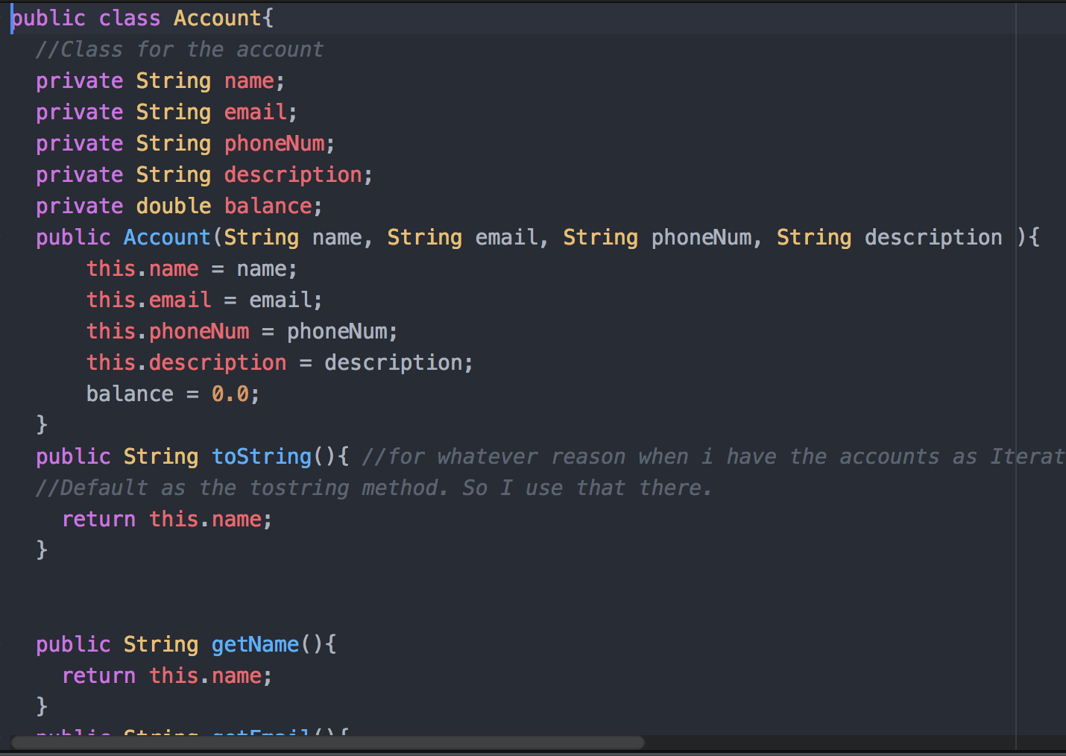
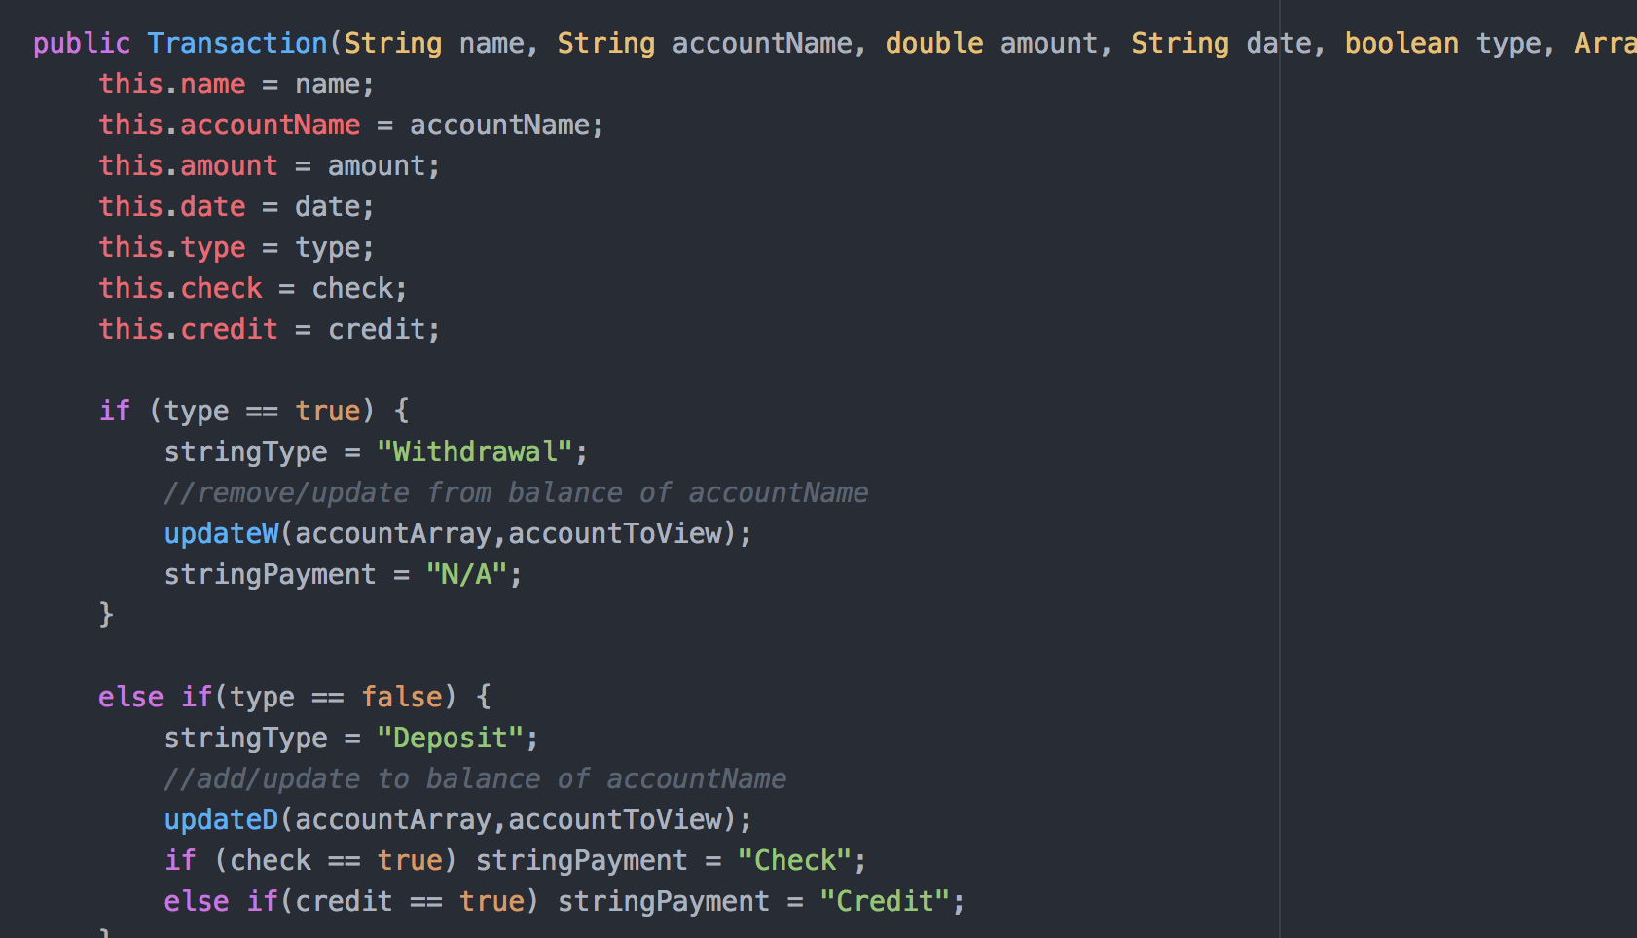
MODEL
MAIN CLASSES
Account
Transaction
Withdrawal
Deposit
Save File
Transaction File

Slide 6
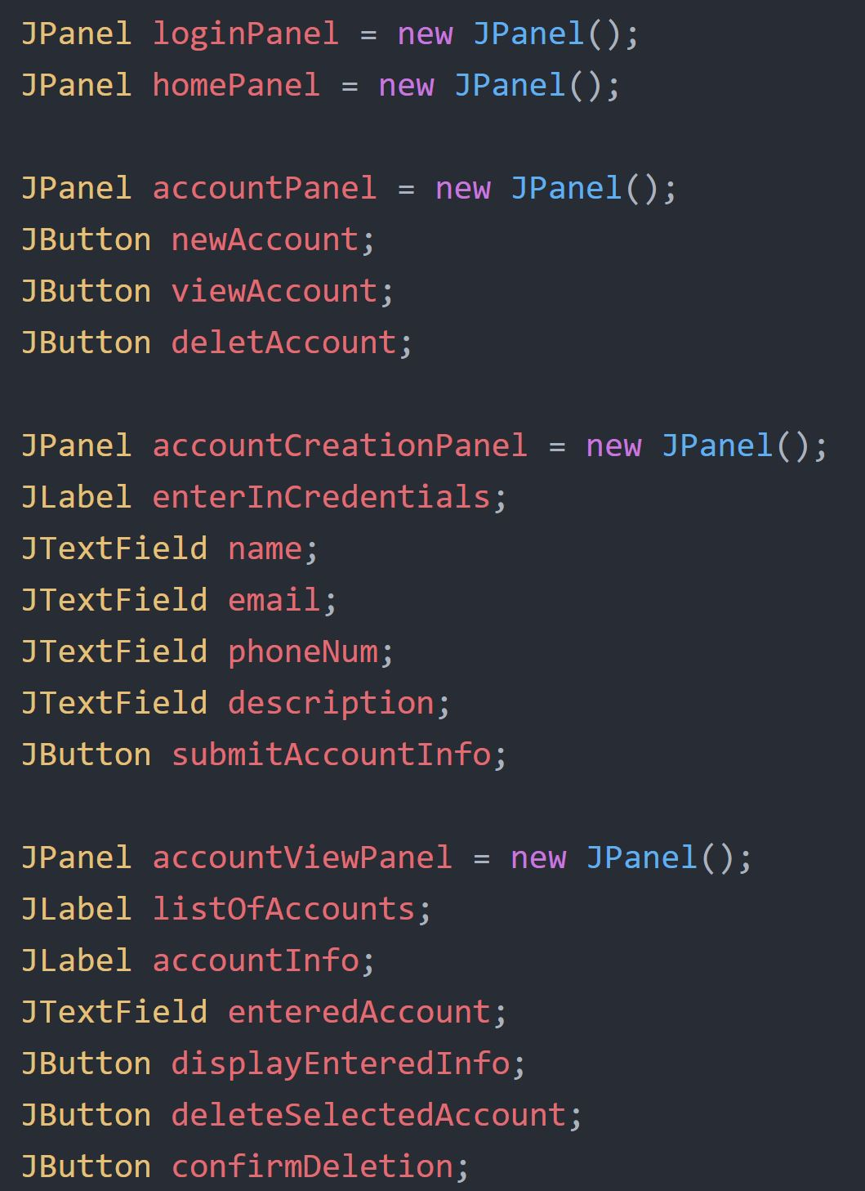
VIEW
CODE EXAMPLE:
MAIN FRAME
PANELS
LogInPanel
HomePanel
AccountPanel
Etc.
PANEL CONTENT
Jlabels, Dropdown Lists
JButtons
JTextFields, JPasswordFields
Logo!
Executable .jar file

Slide 7
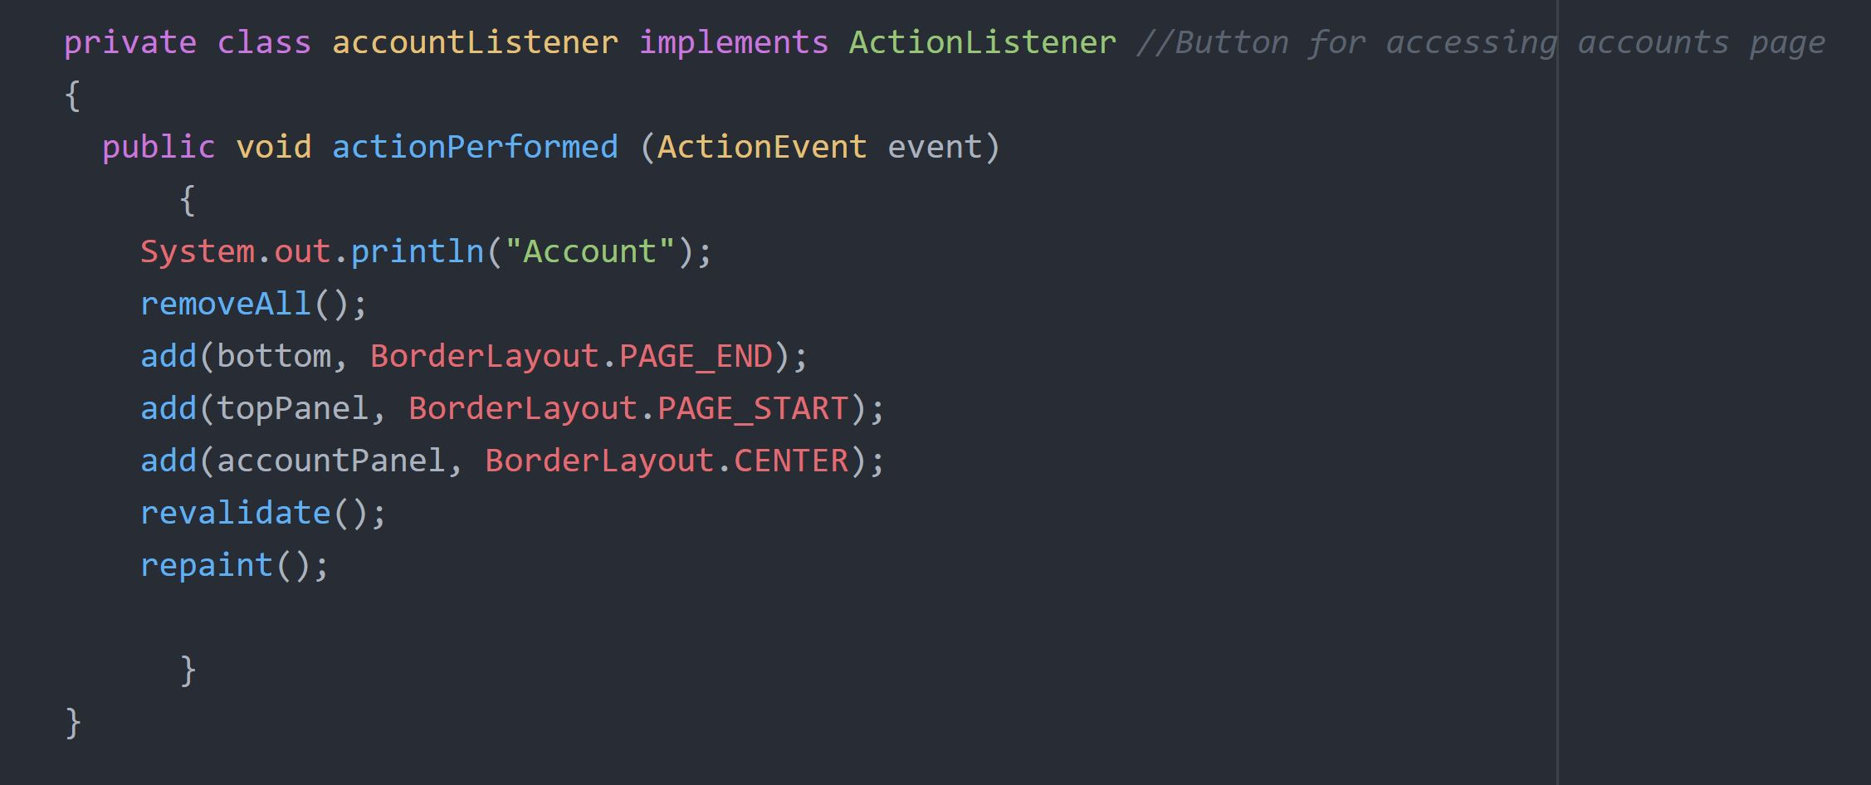
Controller
CODE EXAMPLES:
LISTENERS
ActionListeners for all JButtons:
Home
Logout
Account, create account, delete account
New Transactions
Click to delete textfields

